Slide 1
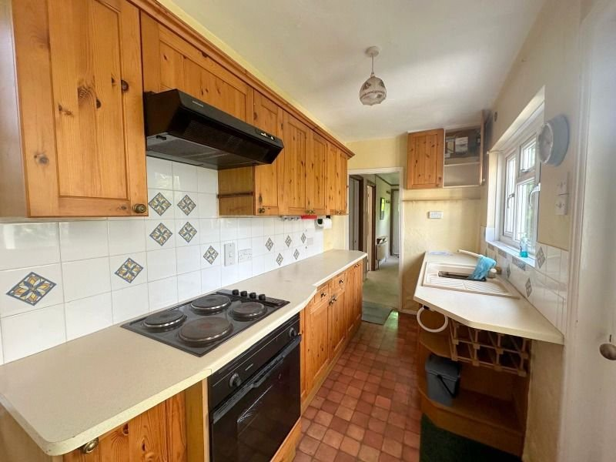
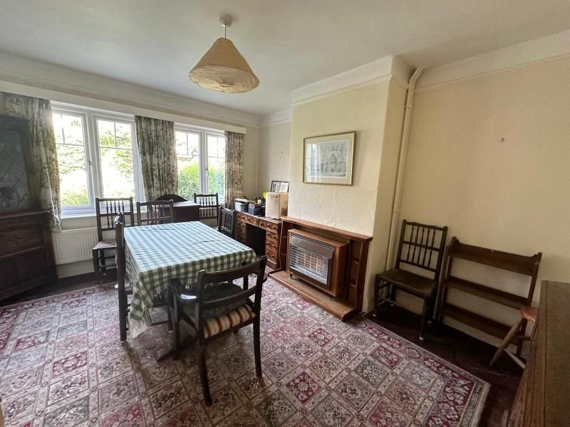
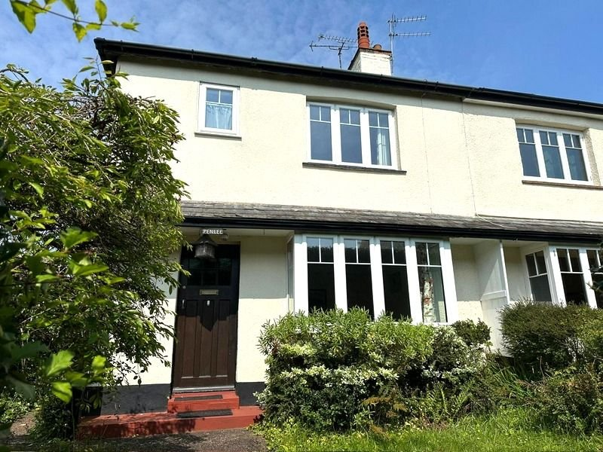
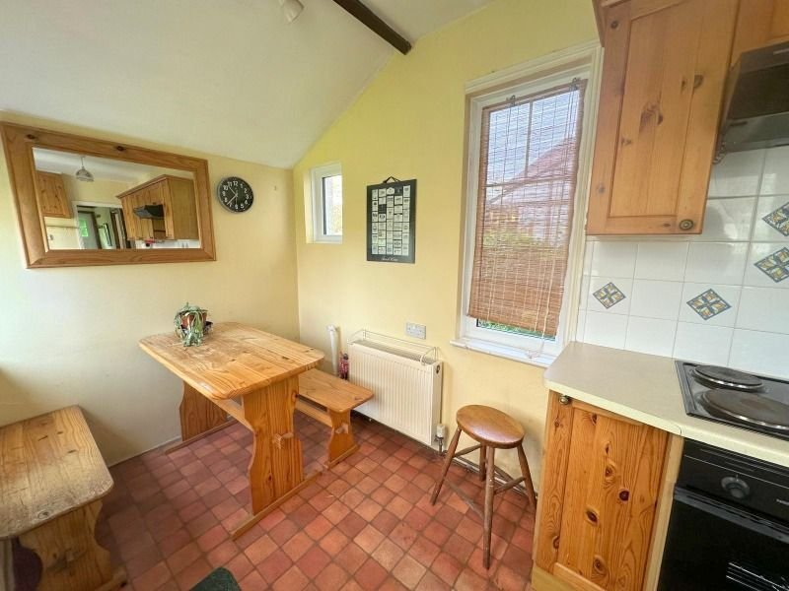
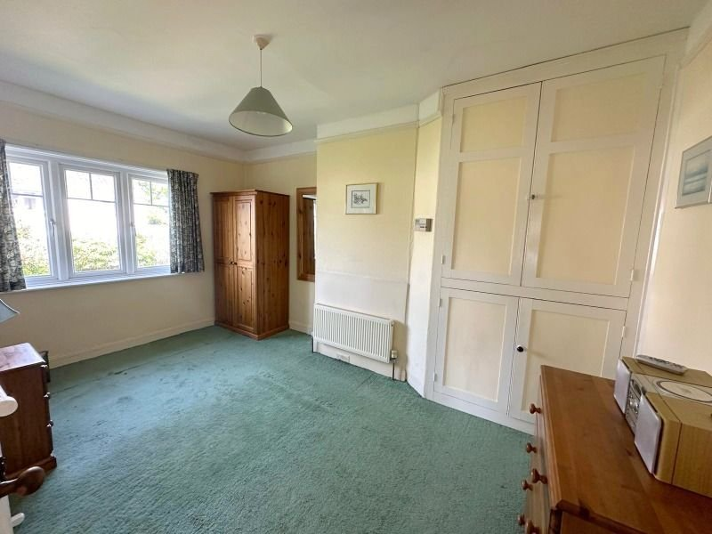
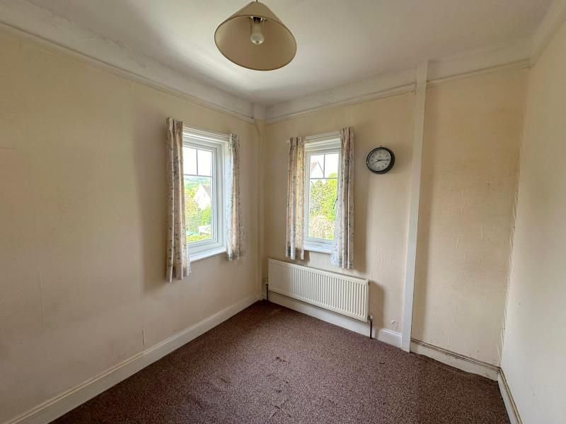
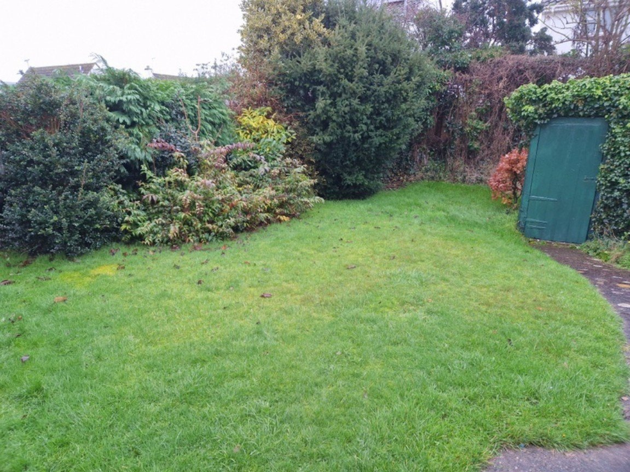
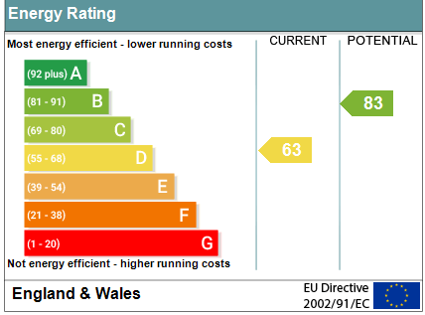
www.pennys.net
Penlee, Middletown Street, East Budleigh, EX9 7EQ
GUIDE PRICE £385,000
TENURE Freehold
A 1930's Built Semi Detached House Enjoying A Sought After Village Setting With Attractive Gardens, Driveway Parking And Good Size Garage
Reception Hall • Lounge With Square Bay Window •
Dining Room • Kitchen/Breakfast Room • Cloakroom/WC •
Three Bedrooms • Bathroom/WC •
Gas Central Heating • uPVC Double Glazed Windows •
No Onward Chain •
Pennys Estate Agents Limited for themselves and for the vendor of this property whose agents they are give notice that:- (1) These particulars do not constitute any part of an offer or a contract. (2) All statements contained in these particulars are made without responsibility on the part of Pennys Estate Agents Limited. (3) None of the statements contained in these particulars are to be relied upon as a statement or representation of fact. (4) Any intending purchaser must satisfy himself/herself by inspection or otherwise as to the correctness of each of the statements contained in these particulars. (5) The vendor does not make or give and neither do Pennys Estate Agents Limited nor any person in their employment has any authority to make or give any representation or warranty whatever in relation to this property.
PENNYS ESTATE AGENTS
2 Rolle House, Rolle Street, Exmouth, Devon, EX8 2SN
Tel: 01395 264111 EMail: help@pennys.net

Slide 2
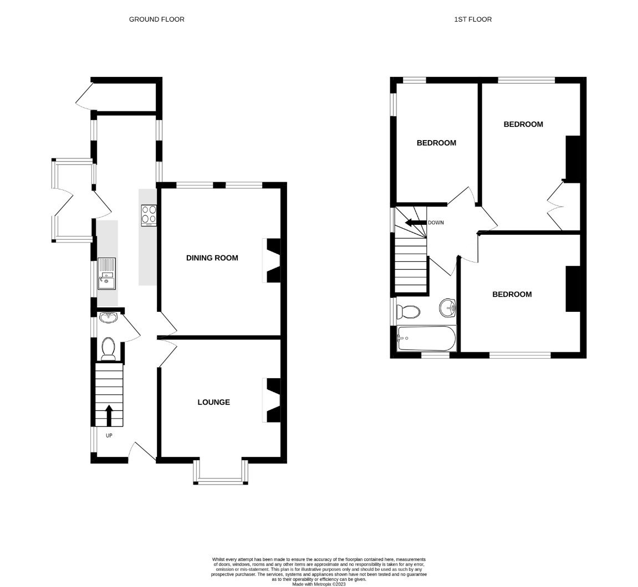
Penlee, Middletown Street, East Budleigh, EX9 7EQ
Penlee is situated in the East Devon village of East Budleigh (the birth place of Sir Walter Raleigh) and a short distance inland from the popular coastal town of Budleigh Salterton. East Budleigh was once a market town and thriving port when the River Otter was navigable, but today it is regarded as a special place to live, with its attractive village centre. East Budleigh is conveniently positioned for ease of access to Junction 30 of the M5 being approximately 8 miles away and also has a community shop and pub close by. There is also hourly bus services available to Exmouth, Sidmouth & Budleigh Salterton, there is also a day service available to Exeter and back. Budleigh Salterton possesses a good range of local convenience and specialist shops, numerous pubs and restaurants, an excellent range of recreational facilities, including East Devon Golf Club. THE ACCOMMODATION COMPRISES: ENTRANCE PORCH: With courtesy light; solid wood front door to: RECEPTION HALL: Radiator with shelf over; uPVC double glazed window to side aspect; picture rail; stairs to first floor landing with understairs cupboard beneath. CLOAKROOM/WC: Wash hand basin with tiled splash back; WC; radiator; uPVC double glazed window to side aspect. LOUNGE: 4.04m x 3.4m (13'3" x 11'2") into uPVC double glazed bay window to front aspect; tiled fire place and hearth housing coal effect gas fire; television point; picture rail; radiator; fitted shelving in wall recess. DINING ROOM: 4.24m x 3.43m (13'11" x 11'3") Fitted gas fire in fire surround; radiator; picture rail; two uPVC double glazed windows to rear elevation. KITCHEN/BREAKFAST ROOM: 5.59m x 1.75m (18'4" x 5'9") Fitted with a range of work top surfaces with cupboards, and drawer units beneath; tiled surrounds and inset single drainer sink unit; four ring electric hob with filter extractor hood over and built-in oven beneath; wall mounted cupboards; plumbing for an automatic washing machine; five sets of uPVC double glazed windows; radiator; part glazed door to: SIDE PORCH: 2.08m x 1.22m (6'10" x 4'0") uPVC double glazed windows overlooking REAR GARDEN and uPVC double glazed door to OUTSIDE. FIRST FLOOR LANDING: Access to roof space; uPVC double glazed window to side aspect; picture rail. BEDROOM ONE: 3.35m x 2.74m (11'0" x 9'0") Built-in full length range of wardrobes; radiator; picture rail; uPVC double glazed window to front aspect. BEDROOM TWO: 4.27m x 2.97m (14'0" x 9'9") uPVC double glazed window to rear aspect; radiator; picture rail; cupboard housing Worcester gas boiler. BEDROOM THREE: 3.25m x 2.36m (10'8" x 7'9") uPVC double glazed windows to side and rear aspects; radiator; picture rail.
BATHROOM/WC: Comprising of bath with shower over, shower curtain and rail; pedestal wash hand basin; WC; radiator; shaver socket; mirror fronted medicine cabinet; tiled splash prone areas; radiator; two uPVC double glazed windows to front and side aspects. OUTSIDE: A pedestrian gate and pathway to the property with lawn gardens to either side and shrub beds, driveway parking and garage. Pathway leads to an attractive rear garden comprising of lawn gardens, mature shrubs, outside store and shed. GARAGE: 5.59m x 2.9m (18'4" x 9'6") Electric door; door to REAR GARDEN; power and light connected.
FLOOR PLAN:

